Slide 1
Module 2: Supervised Learning on Network Traffic
Linear and Logistic Regression
ML for Cybersecurity
Fall 2020

Slide 2
Learning Objective

Slide 3
Learning Objectives
Review (simple) supervised learning machine learning models
Linear regression
Logistic regression
Naïve Bayes
Apply these models to real-world examples on network traffic

Slide 4
Examples of Supervised Learning
Linear Models
Linear regression: Predictions of continuous values
Logistic regression: Binary classification
Support vector machines: Multi-class classification
Tree-Based Models
Random forest
Gradient boosted trees
Deep Learning Models

Slide 5
LINEAR REgression

Slide 6
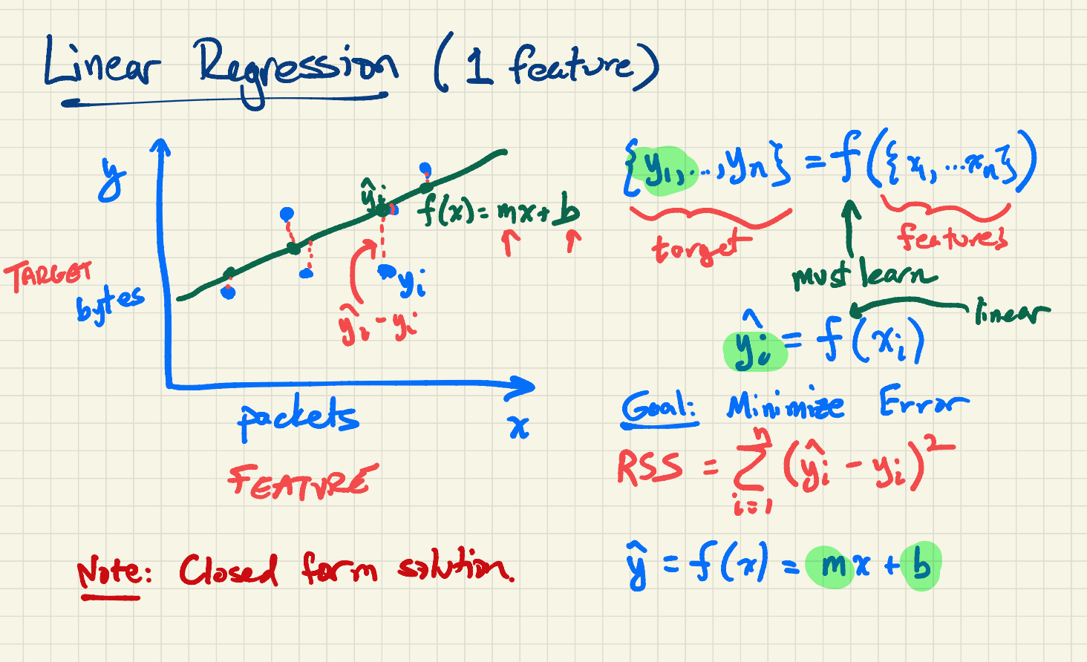

Slide 7
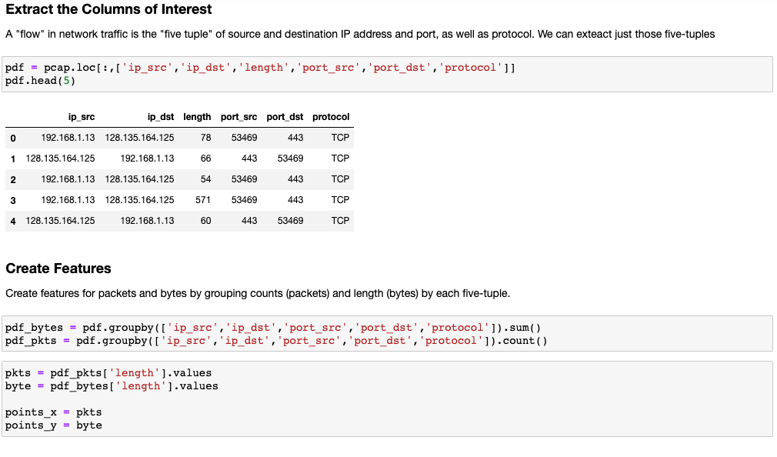

Slide 8
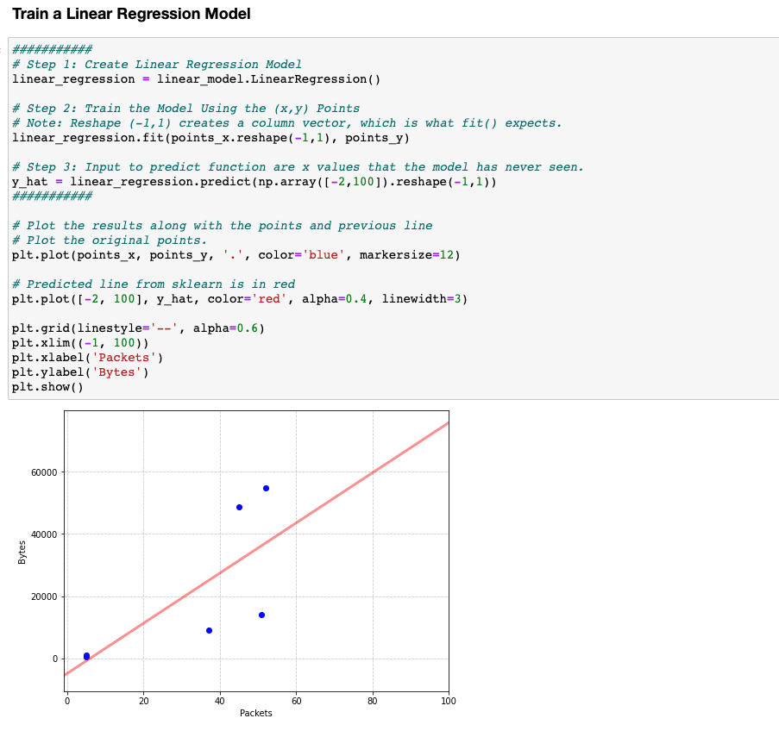

Slide 9
Logistic Regression

Slide 10
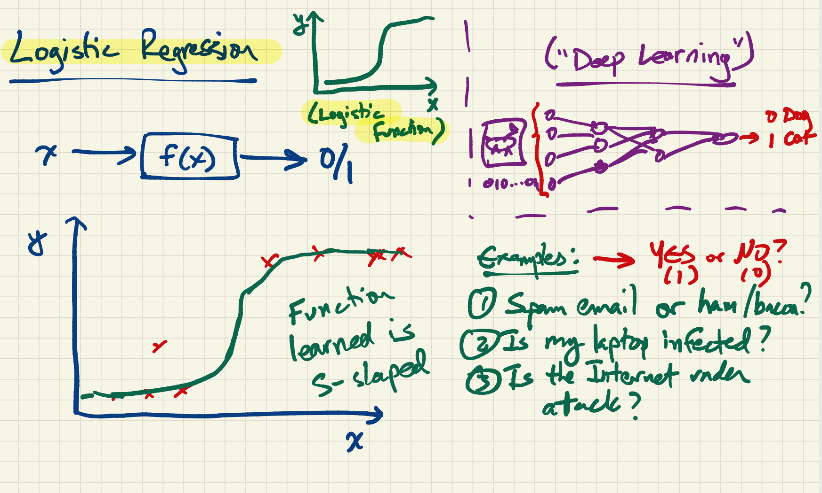

Slide 11
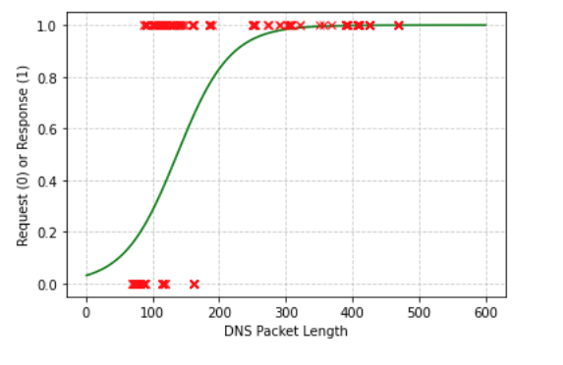
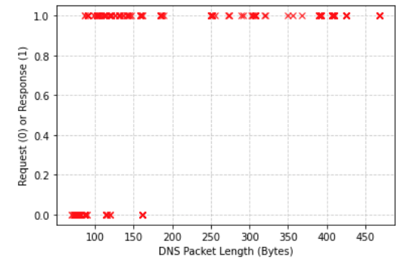
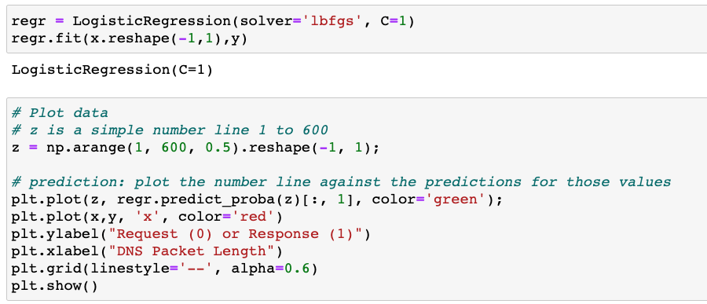

Slide 12
NaÏVe Bayes

Slide 13
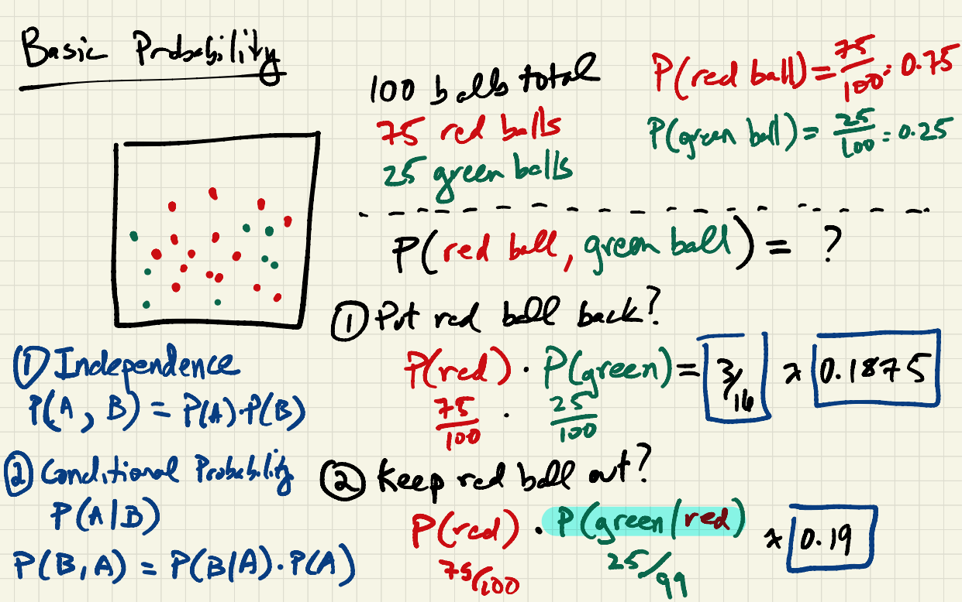

Slide 14
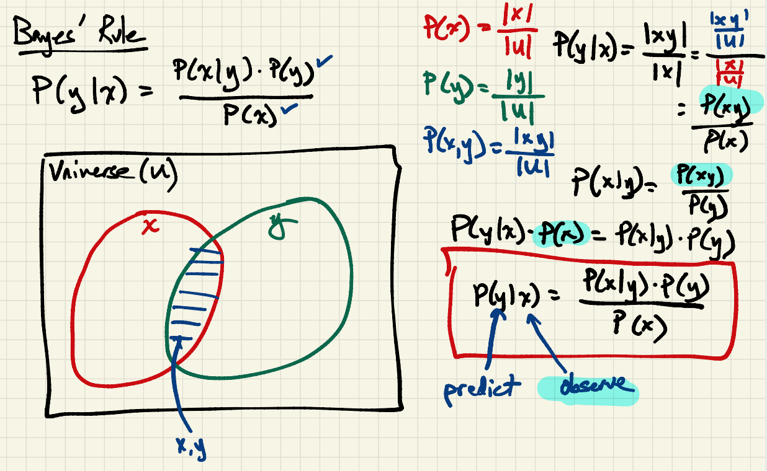

Slide 15
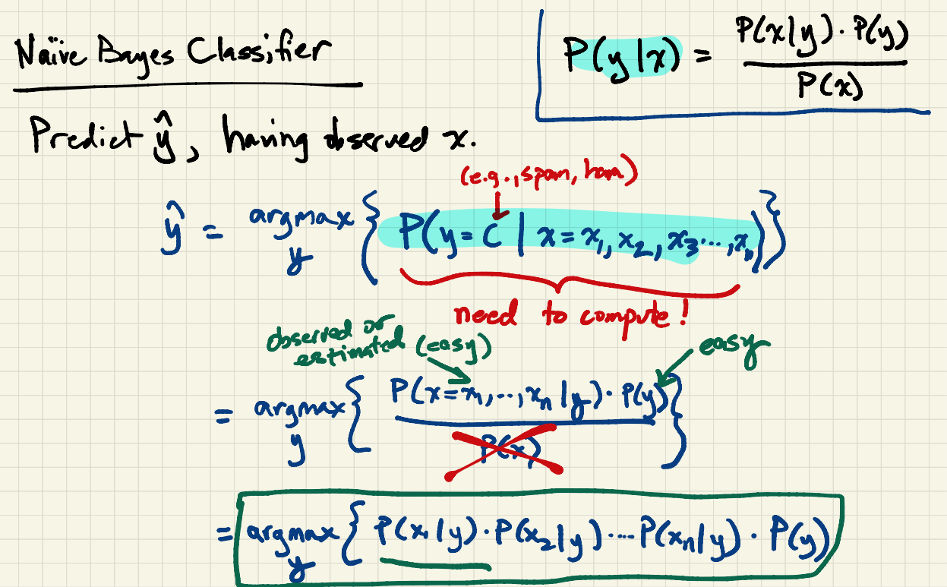

Slide 16
